Slide 1
Phonetics & Intonation
Dr. Gajanan T. Hivale
Assistant Professor (English)
Department of Humanities and Social Sciences
NIT , GOA.

Slide 2
Overview
Phonetics
Intonation
Pitch
Sress
Word stress, sentence stress.
Tone

Slide 3
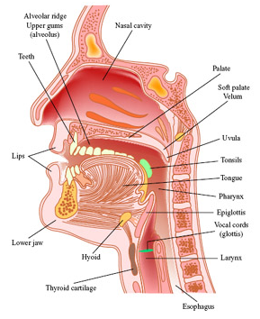
Definition
Phonetics is defined as the study of the sounds of human speech using the mouth, throat, nasal and sinus cavities, and lungs.

Slide 4
Three Branches of Phonetics (1/2)
Phonetics
Acoustic
Auditory
Articulatory

Slide 5
Three Branches of Phonetics (2/2)
Acoustic Phonetics This is the study of the sound waves made by the human vocal organs for communication and how the sounds are transmitted.
Auditory Phonetics How we perceive and hear sounds and
How the ear, brain and auditory nerve perceives the sounds
The physiological processes involved in the reception of speech
Articulatory Phonetics Movement of various parts of the vocal tract during speech. (voiceless).

Slide 6
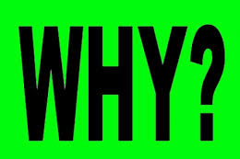

do we need to study Phonetics?

Slide 7
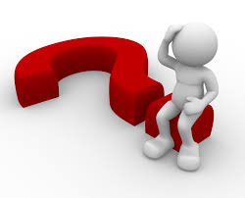

Ghoti Fish

Slide 8
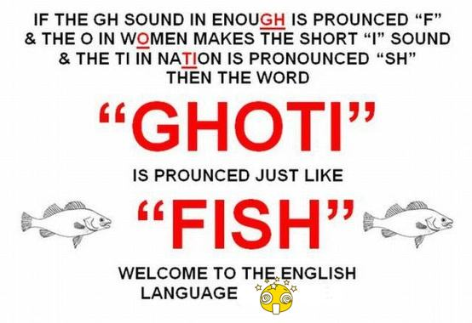

Slide 9
English pronunciation is not dependent on the word spelling
Some quirkiness...

Slide 10
‘A’: one alphabet, many pronunciations
Bat
After
About
Many
Law
Day

Slide 11
Same Pronunciation...
Ship
Measure
National
Non-chalant
patient

Slide 12
Same word, different pronunciations...
Lead, lead
Bow, bow
Read, read
Wound, wound
Sow,sow
Tear, tear

Slide 13
Phonetic Symbols
Consonants

Slide 14
p pen, copy, happen b back, baby, job t tea, tight, button d day, ladder, odd k key, clock, school g get, giggle, ghost tʃ church, match, nature | dʒ judge, age, soldier f fat, coffee, rough, photo v view, heavy, move θ thing, author, path ð this, other, smooth s soon, cease, sister | z zero, music, roses, buzz ʃ ship, sure ʒ pleasure, vision h hot, whole, ahead m more, hammer, sum n nice, know, funny, sun ŋ ring, anger, thanks, sung national | l light, valley, feel r right, wrong, sorry, arrange j yet, use, beauty, few w wet, one, when, queen

Slide 15
Phonetic Symbols
Vowels

Slide 16
ɪ kit, bid, hymn, minute e dress, bed, head, many æ trap, bad ɒ lot, odd, wash ʌ strut, mud, love, blood ʊ foot, good, put iː fleece, sea, machine | eɪ face, day, break aɪ price, high, try ɔɪ choice, boy uː goose, two, blue, group əʊ goat, show, no aʊ mouth, now ɪə near, here, weary | eə square. fair, various ɑː start, father ɔː thought, law, north, war ʊə poor, jury, cure ɜː nurse, stir, learn, refer ə about, common, standard | i happy, radiate. glorious u thank you, influence, situation n̩ suddenly, cotton l̩ middle, metal ˈ (stress mark)

Slide 17
INTONATION

Slide 18
What is intonation? Intonation is a term used to refer to the distinctive use of different patterns of pitch that carry meaningful information.

Slide 19
Let’s consider the following example:
Question: What is the difference in the way the following two sentences sound?
He is going tomorrow.
He is going tomorrow?
The melody of sentence A drops at the end, making it a statement.
The melody of sentence B rises at the end, making it a question.
In languages like English, we call these sentence melodies intonations.
All spoken languages have intonations.

Slide 20
Pitch
Defined in terms of high and low.
Auditory sensation experienced by the hearer.
We are not interested in all aspects of a speaker´s pitch, but in those that carry some linguistic information
Speakers have control over their own pitch of voice, and the possibility of choice.

Slide 21
STRESS
In linguistics, stress is the relative emphasis that may be given to certain syllables in a word.
Eg. Communi`cation.
`Teacher.
Engi`neer.
`Engine

Slide 22
Understanding Syllables
To understand word stress, it helps to understand syllables.
Every word is made from syllables.
Each word has one, two, three or more syllables.

Slide 23
Word syllables
Word |  | Number of syllables
Dog | Dog | 1
Quiet | Qui-et | 2
Expensive | Ex-pen-sive | 3
Interesting | In-ter-est-ing | 4
Unexceptional | Un-ex-cep-tion-al | 5

Slide 24
The realization of stress in English
In English, the three ways to make a syllable more prominent are to make it:
louder
longer
higher pitched (usually)

Slide 25
Word Stress Quiz
Can you pass me a plas/tic knife?
I want to take a pho/to/gra/phy class.
U/ni/ver/sity is where we get our degree.
Please turn off the tel/e/vi/sion before you go out.
I can't de/cide which book to borrow.
Do you un/der/stand this lesson?
It is cri/ti/cal that you finish your essay.

Slide 26
Identify the stressed syllable
Confirmation
Eighteen.
Career
Enthusiasm
Everyone
Production
Architecture.
Decision

Slide 27
Indicate if any change in Stress
Department- departmental
Origin- original
Access- accessible
Effect- effective
Appear-appearance.

Slide 28
Sentence Stress in English
Sentence stress is the music of spoken English. Like word stress, sentence stress can help you to understand spoken English, especially when spoken fast.
Sentence stress is what gives English its rhythm or "beat". You remember that word stress is accent on one syllable within a word. Sentence stress is accent on certain words within a sentence.

Slide 29
Most sentences have two types of word:
content words
structure words
Content words are the key words of a sentence. They are the important words that carry the meaning or sense.
Structure words are not very important words. They are small, simple words that make the sentence correct grammatically.
If you remove the structure words from a sentence, you will probably still understand the sentence.

Slide 30
Rules for Sentence Stress in English
The basic rules of sentence stress are:
content words are stressed
structure words are unstressed
the time between stressed words is always the same

Slide 31
Imagine that you receive this telegram message:
 |  | SELL |  | CAR |  |  | GONE |  | FRANCE
 |  | SELL | my | CAR |  | I’ve | GONE | to | FRANCE
Will | you | SELL | my | CAR | because | I’ve | GONE | to | FRANCE

Slide 32
Tone
A unit of speech bounded by pauses has movement, of music and rhythm, associated with the pitch of voice. This certain pattern of voice movement is called 'tone'.
By means of tones, speakers signal whether to refer, proclaim, agree, disagree, question or hesitate, or indicate completion and continuation of turn-taking, in speech.

Slide 33
Types
fall
low-rise
high-rise
fall-rise

Slide 34
Fall (A Falling Tone)
A falling tone is by far the most common used tone of all. It signals a sense of finality, completion, belief in the content of the utterance, and so on.
A speaker, by choosing a falling tone, also indicates to the addressee that that is all he has to say, and offers a chance (turn-taking) to the addressee to comment on, agree or disagree with, or add to his utterance.

Slide 35
Example
Consequences of his unacceptable behavior.
I'll report you to the HEADmaster
A falling tone may be used in referring expressions as well.
I've spoken with the CLEAner.
Questions that begin with wh-questions are generally pronounced with a falling tone:
Where is the PENcil?
Imperative statements have a falling tone.
i) Go and see a DOCtor.
Requests or orders have a falling tone too.
i) Please sit DOWN
Exclamations:
Watch OUT!
Yes/No questions and tag questions seeking or expecting confirmation
a) You like it, DON'T you? b) YEES.
Here it is used when it is sure that the answer is yes.
Have you MET him? b) YES.

Slide 36
Low Rise (A Rising Tone)
This tone is used in genuine 'Yes/No' questions where the speaker is sure that he does not know the answer, and that the addressee knows the answer. Such Yes/No questions are uttered with a rising tone. For instance, consider the following question uttered with a rising tone, the answer of which could be either of the three options:
A) Isn't he NICE
B) i) Yes. ii) No. iii) I don't know.
Compare the above example with the following example, which is uttered with a falling tone, and which can only have one appropriate answer in the context:
a) Isn't he NICE
b) YES.

Slide 37
High Rise (A Rising Tone)
If the tonic stress is uttered with extra pitch height, as in the following intonation units, we may think that the speaker is asking for a repetition or clarification, or indicating disbelief.
Examples
a) I'm taking up graphology this vacation. b) Taking up WHAT? (clarification)
a) She passed her DRIving test. b) She PASSED? (disbelief)

Slide 38
Fall Rise
Fall-rise signals dependency, continuity, and non-finality. It generally occurs in sentence non-final intonation units.
Consider the following in which the former of the intonation units are uttered with a fall-rise tone (the slash indicates a pause):
Private enterPRISE / is always EFficient.
A quick tour of the CIty / would be NICE.
PreSUmably / he thinks he CAN.
Usually / he comes on SUNday.

Slide 39
THANKYOU

